Slide 1
CloudProtect : A Middleware for Managing Privacy in Cloud
Dissertation Author
Mamadou Hassimiou Diallo,
UC Irvine
Presented By
Joy Rahman & Prosunjit Biswas
UTSA

Slide 2
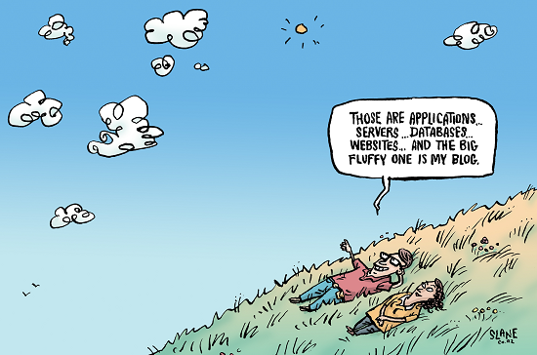
Motivation
When user uploads her data to a cloud provider, she has no control over the security and privacy of the data.
All data does not require same level of privacy or security.
Example. You email on cloud require more privacy over your uploaded audio song.
A framework is required where a user can define her own notion of privacy and security.

Slide 3
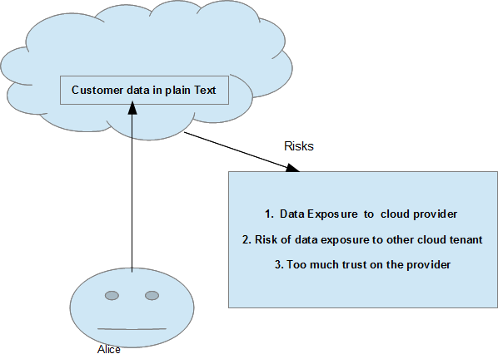
The Problem

Slide 4
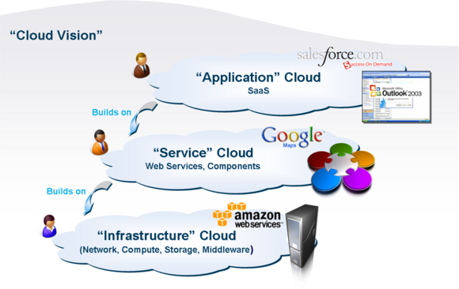
Scope of the Problem
Their Scope is at Software as a Service / Storage as a Service Layer (SaaS).
Example: dropbox, google calender, gmail so on.
Their scope is not at Infrastructure as a service layer (IaaS).

Slide 5

The Solution Should Meet the Requirements
No major change on provider side.
Most Data utility should preserve. Ex: data searching, sharing.
User can define her own notion of privacy and security.
Example: Alice decide which of her data require most security or privacy.
Minimum overhead

Slide 6
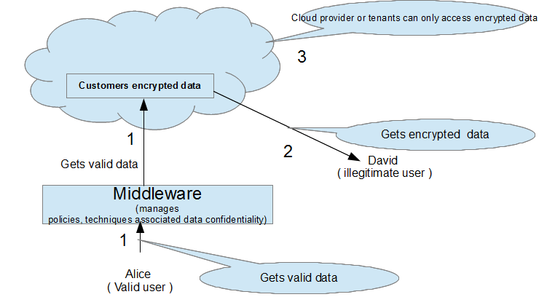
The solution(CloudProtect)

Slide 7
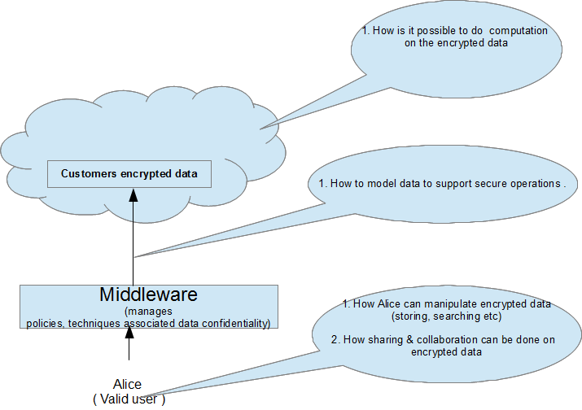
Sub problems Related to Solutions

Slide 8
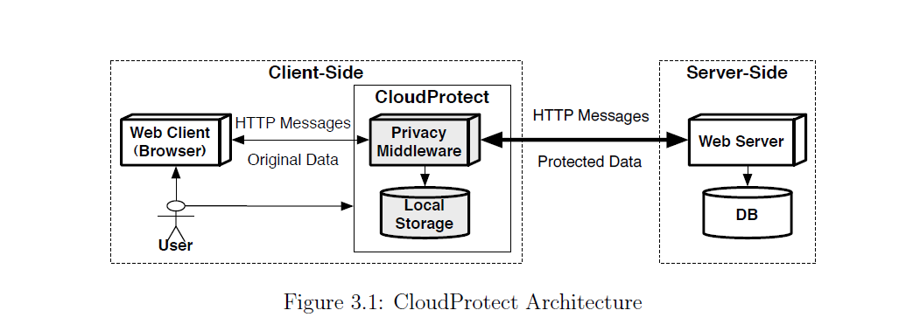
CloudProtect Framework (overview)

Slide 9
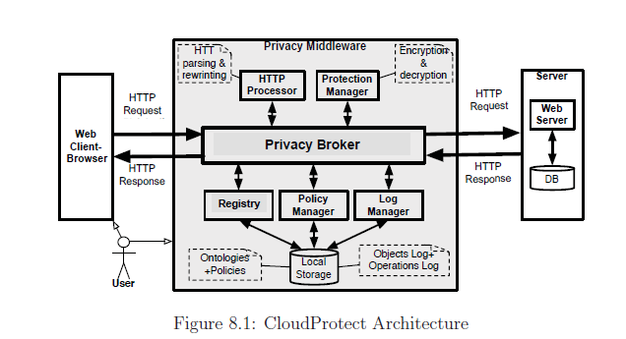
Cloud Protect Framework (Elaborated)

Slide 10
Modeling Data & Function in CloudProtect
Data Model
Data Category
Data Hierarchy
Function Model
CRUD (create, read, write, delete),
Searching
Sharing / collaboration
Data Confidentiality Policy
Policy Rules
Rule Exception

Slide 11
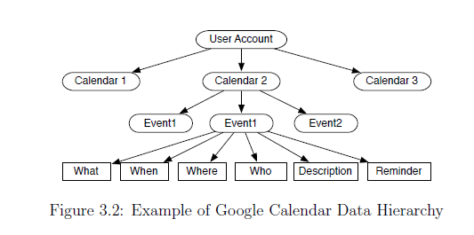
Data Model
The modeled data as a set of n multidimensional object {o₁,o₂… o_{n}}, where each object o_{i} is a tuple of k attributes {A₁,A₂,…A_{k}}

Slide 12
Policy Model
Their Policy Language is expressed by
C -> Represent(o.A) >= Level
Where C is conjunctive Predicate
Represent(o.A) Indicates protection to be applied on o.A
Level indicate one of the possible protection mechanism (SP – Strong Protection, WP – weak Protection, NP – No protection)

Slide 13
Example Policy
“Encrypt the body of any document if the title contains the key world ‘report’”.
Expressed in their policy language:
“(doc.title contains ‘report’) → Represent(doc.body) >= SP”

Slide 14
Example2
“No encryption is required if the file type is ‘Public Audio’ ’”.
Expressed in their policy language:
“(file.type is ‘Public Audio ’) → Represent(file) >= NP”

Slide 15
Proposed Solution: CloudProtect Framework ‘Protection Techniques’
Sub-problem:
How to encrypt customer data which support predefined operators on the data
Solution:
Text Based Transformation Techniques
Numerical Transformation Techniques

Slide 16
Searching Encrypted Data

Slide 17
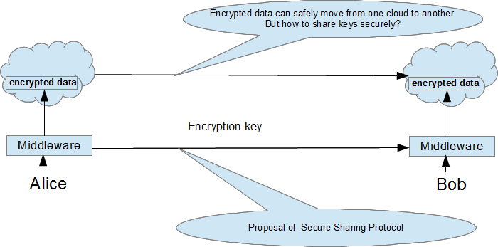
Sharing and Collaboration of Encrypted Data

Slide 18
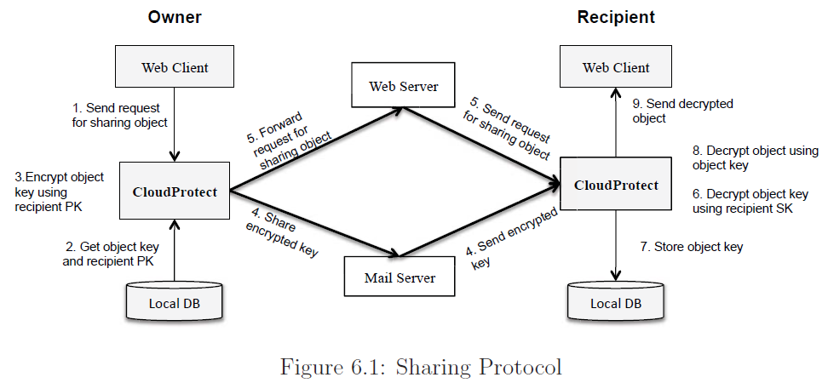
Sharing Protocol

Slide 19
Evaluation

Slide 20
Related Work
Cloud Data Privacy
Security as a Service
Browser Privacy
Secure Data Outsourcing

Slide 21
Their way of organizing related work
They found related work in each area corresponding to their sub problem.

